Slide 1
Jungle Run

Slide 2
Group Members and Roles
Yamil Tarabin- Designer
Jonathan Toulson- Designer
Thomas Gilchrist- Artist
Jamie Barnes- Artist
Harvin Johal- Programmer

Slide 3
Idea And Concept
The artefact that the group envisions is a 2D platformer game called Jungle Run with a cartoon art style, the player will control a female scientist with white hair that works in the research and development department of a company that produces energy drinks, the scientist has gone to a tropical jungle to find new ingredients to create new flavours of energy drinks. On her journey to find new ingredients, the scientist encounters various obstacles that she will have to surpass in order to continue.
The game will revolve around the scientist finding the ingredients, and when the obstacles are encountered, the scientist will use the aforementioned ingredients to make the energy drink that will grant her a power up (each ingredient has its own power up) and permit her to surpass the obstacle.
The game will feature a level system with stages. There will be two levels and in each there will be three stages, each stage will feature one of the ingredients and an obstacle that can only be surpassed when the ingredient found in that stage is converted into an energy drink and drank. The player will have three lives, when the player dies, he will respawn in the last checkpoint. If all three lives are lost the player will be sent back to the start of the level.

Slide 4




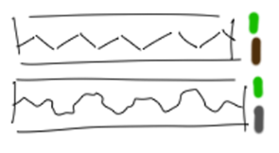
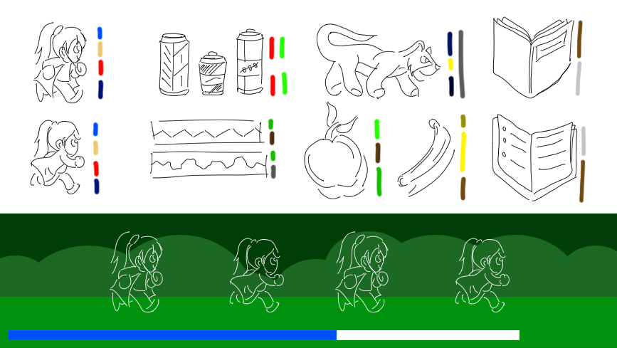
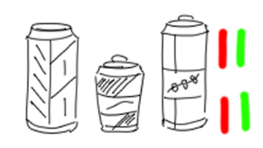

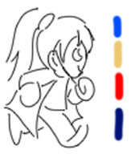

Pre-Production- Low Fidelity
Here are some low level fidelity screenshots that the artists worked on together. A lot of these designs were not used and scrapped, however some were used but just improved upon.

Slide 5
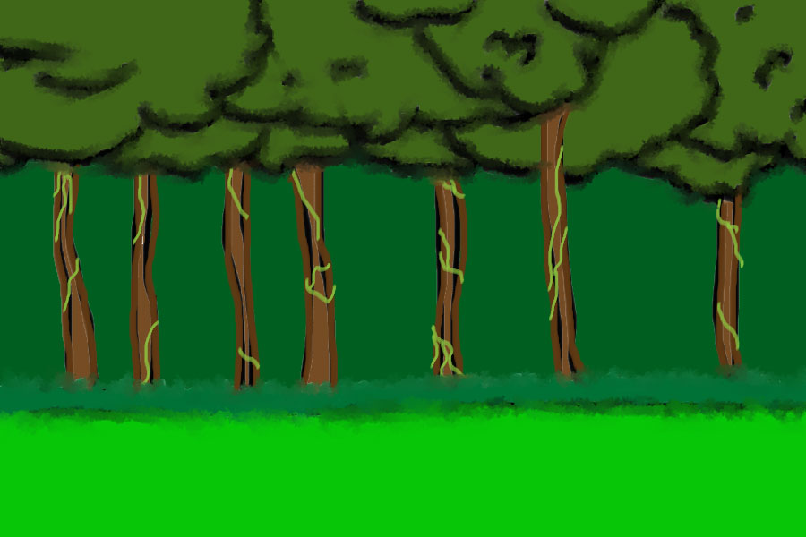
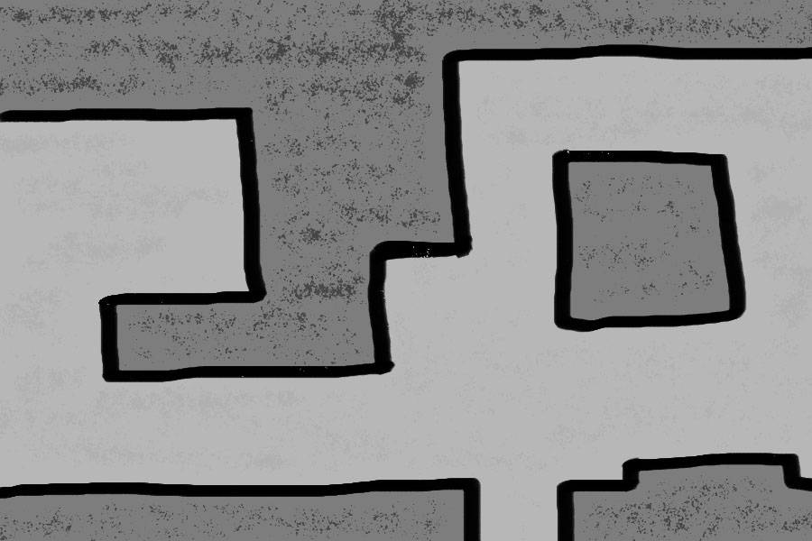

Pre-Production Work- Level Design

Slide 6

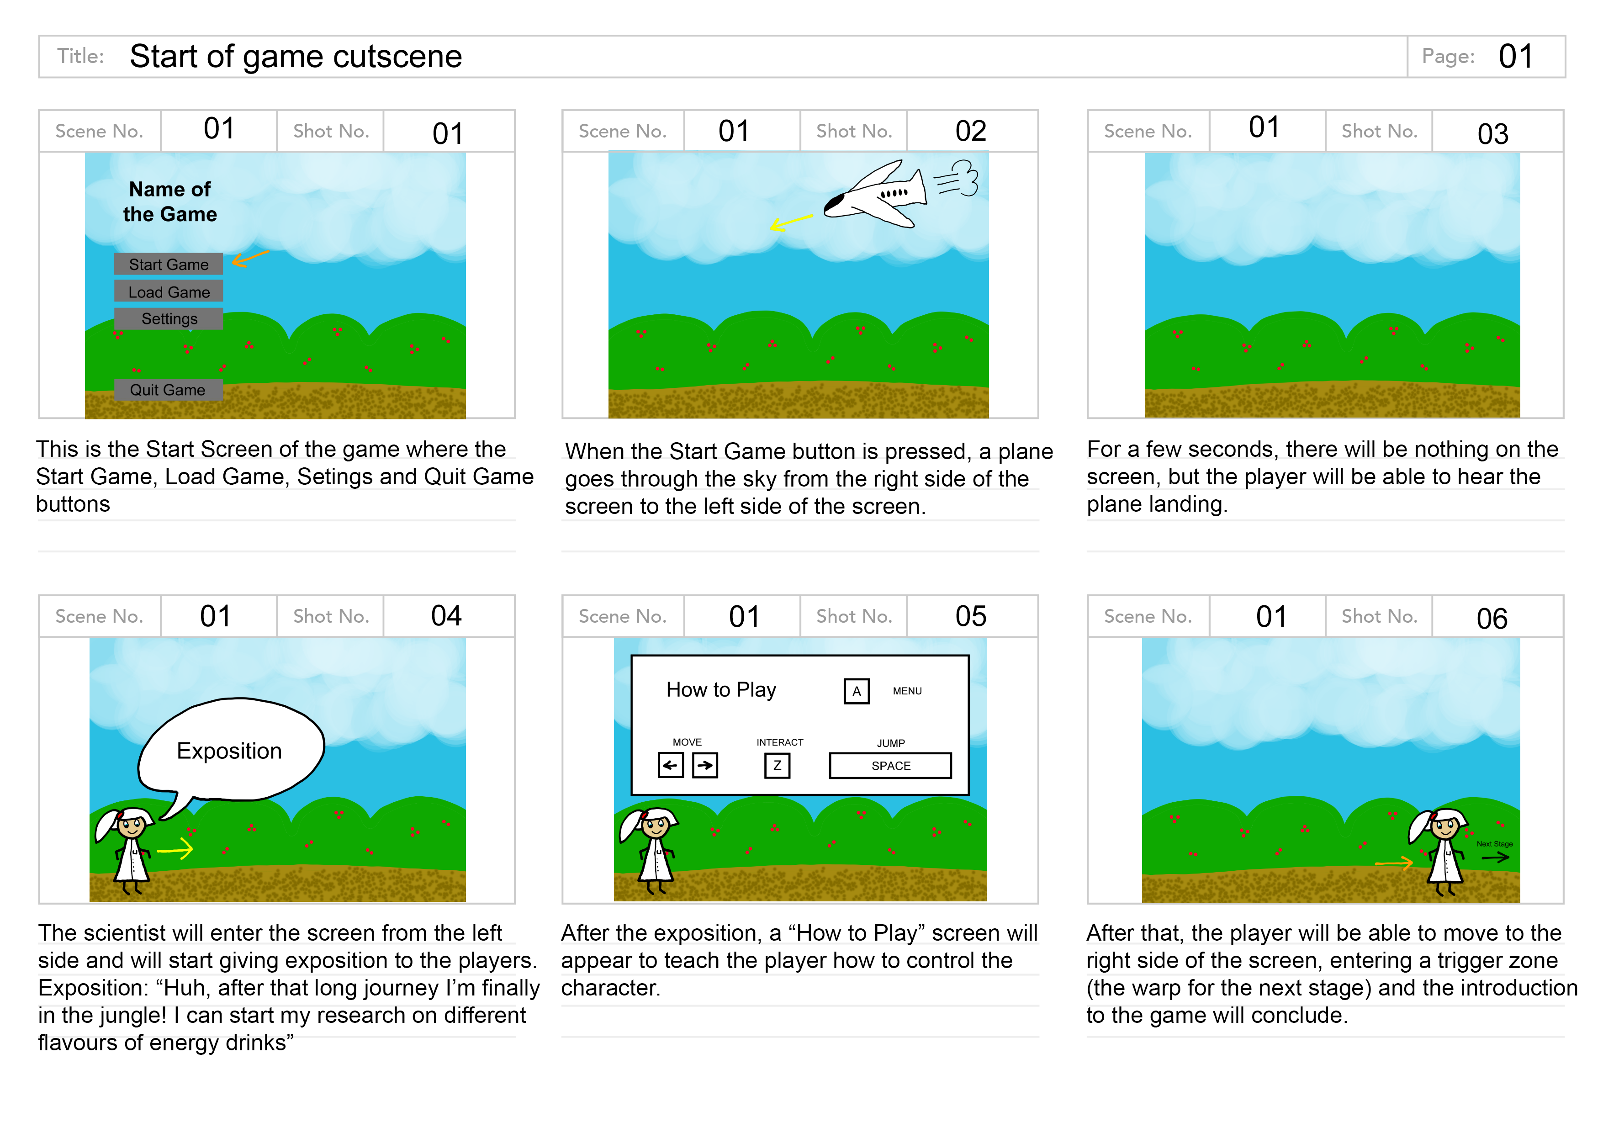
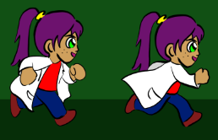
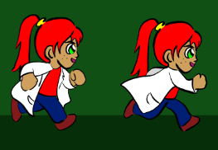
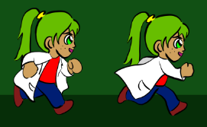
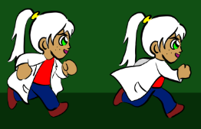
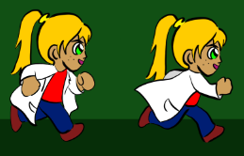
Pre-Production-High Fidelity
Storyboard detailing the opening of the game.
A basic background that for the jungle level.
Some design’s of the main character that weren't used. The main character’s hair would change depending on the fruit they picked up. This would be scrapped later.

Slide 7
Pre-Production Work- Heuristics
Task | Issue | Recommendation
Making sure the player knows how to interact with the project | Minor Usability Problem: Fixing this should be given low priority | The instructions could be made available in the menu
The player should have the ability to skip dialogue | Minor Usability Problem: Fixing this should be given low priority | Show a small indicator that the dialogue can be skipped
The process of making the energy drink will always be the same | Cosmetic Problem Only: Need not be fixed unless extra time is available on project | The menu where the crafting mechanic is could have a single “make” button for all drinks
A prompt should appear before quitting the game and before moving through stages | Minor Usability Problem: Fixing this should be given low priority | The prompt should have a message to the player asking for confirmation
Have the required ingredients to make the energy drink listed on the screen | Cosmetic Problem Only: Need not be fixed unless extra time is available on project | The ingredients could be in the top right, below the amount of lives the player has
The player should be able to go into the menu and see the current objectives | Minor Usability Problem: Fixing this should be given low priority | The objectives should be clearly visible when the player pauses the game
● This Heuristics Evaluation would be used to make sure the player understands what is going on within the game. Also it is a checklist for us so we can promote the product as well as make a good game to advertise it as well.

Slide 8
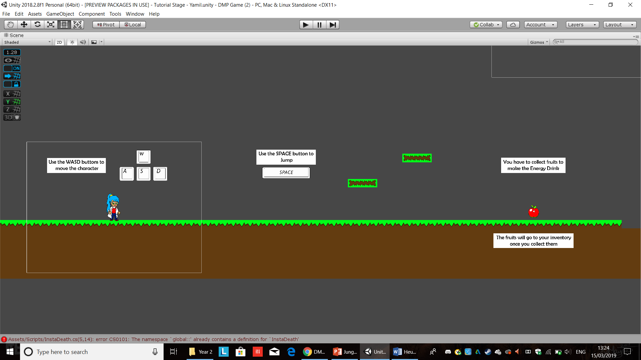
Production Work
The Tutorial Level of the will let the player know what buttons to press and what the focus of the game will be.

Slide 9
Production Work
The software that was used to develop Jungle Run was unity. Within unity some scripts were developed which allows the player to be able to fire rocks at the enemies, also the player can pick up fruit which once all 5 fruits have been collected, the player gains powerups and can reach the end of the stage.
The audio was downloaded through the unity store.
The assets were developed by the artists on the team and edited using photoshop.

Slide 10
Post Production- User Evaluation
User Testing | Ratings
Menu Works | 5
Character Walks | 5
Animation looks good | 4
Enemies Work | 3
Restarting After death | 4
Win/Lose Screen works | 4
Sound Effects Work | 4

Slide 11
How it could be improved
Having the levels and the game be more longer, with checkpoints.
Making the levels tougher and also adding a few more animations, maybe a jump animation.

